Slide 1
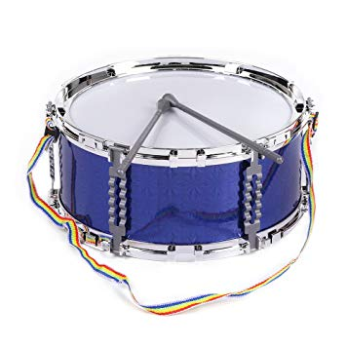
Marching Drums
Stjepan Marjanović, Luka Šaf, Bruno Kudrić, Fran Horvat Nikolas Karač and Mia Bošnjak Mulac

Slide 2
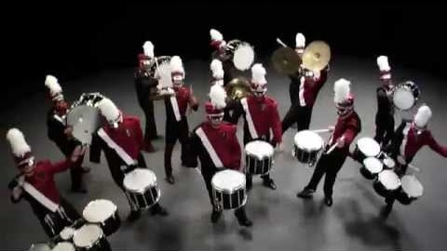
What are marching drums?
Musical Instruments that are used in marching bands include woodwind, brass, and percussion instruments and others that can be carried or worn and played while walking in parade routes or performing during field shows.

Slide 3
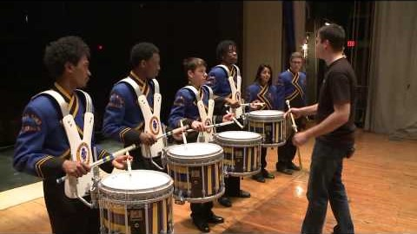
Drum line groove
How to drum?

Slide 4
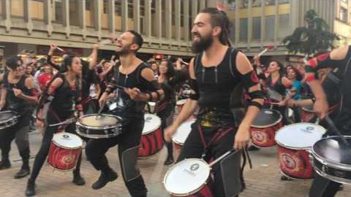
Street parade performances

Slide 5
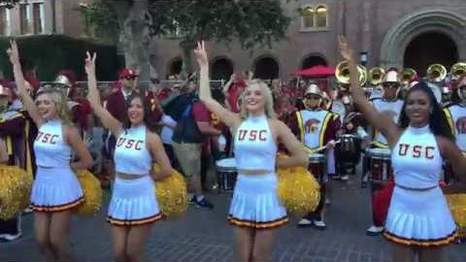
Tribute to Troy - 2019 USC Marching Band and Cheer. Chearleaders

Slide 6
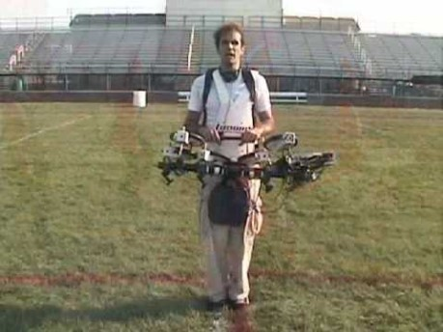
Art performances

Slide 7
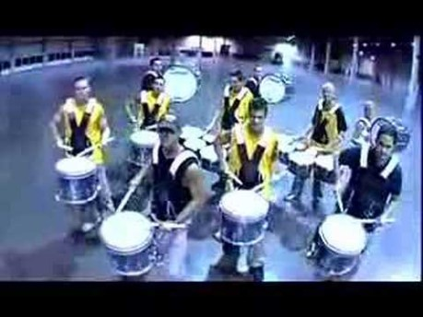
Urban performance- hip hop drummers

Slide 8
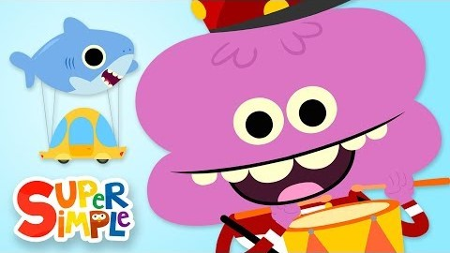
Cartoons

Slide 9
References
https://www.youtube.com/watch?time_continue=1&v=1ZwVoNUvaAE&feature=emb_logo
https://www.youtube.com/watch?v=eCIvvFe7bg4&feature=emb_logo
https://www.youtube.com/watch?v=0Pq8vOVbvzs&feature=emb_logo
https://www.youtube.com/watch?v=ZuBzsYI6CxM&feature=emb_logo
https://www.youtube.com/watch?v=f6wBD6DEKIY&feature=emb_logo
https://www.youtube.com/watch?time_continue=1&v=osHT73lWMD0&feature=emb_logo
https://www.youtube.com/watch?v=1h6F-YngTi0&feature=emb_logo

